Slide 1
GateWay
Internal | Fixed-Term Phuong Le Trung (RBVH/EJV23) | 1/3/2021.

Slide 2
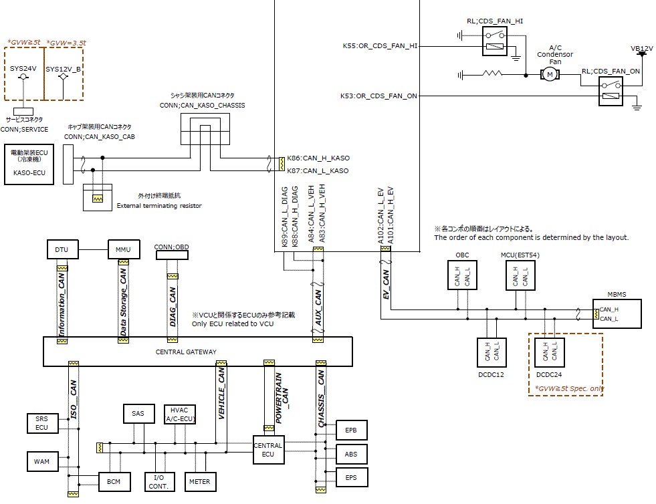
Overview
VCU
Gateway
Tester
CGW
Internal | Fixed-Term Phuong Le Trung (RBVH/EJV23) | 1/3/2021.

Slide 3
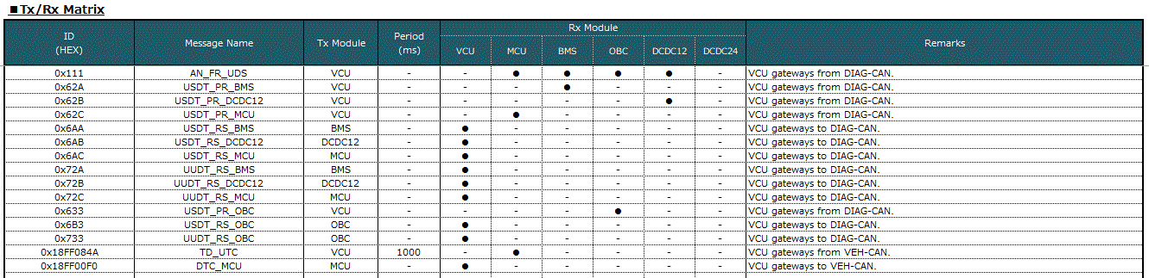
Overview
Internal | Fixed-Term Phuong Le Trung (RBVH/EJV23) | 1/3/2021.

Slide 4
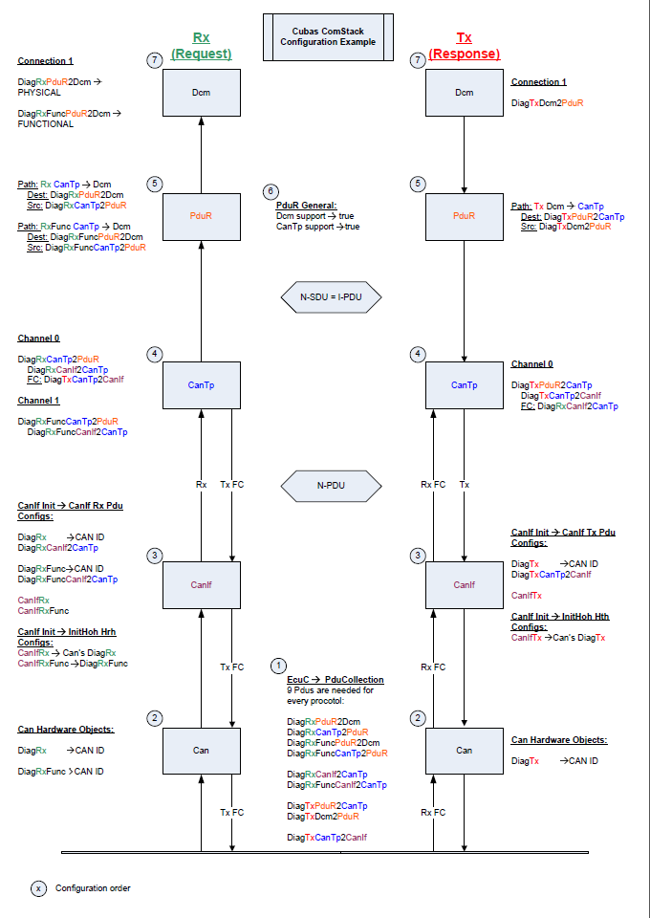
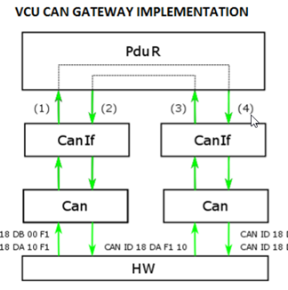
Solution
CAN→ CANIf → CanTp → PduR→ DCM
CAN→ CANIf → PDUR → another CANIf → CAN
Internal | Fixed-Term Phuong Le Trung (RBVH/EJV23) | 1/3/2021.

Slide 5
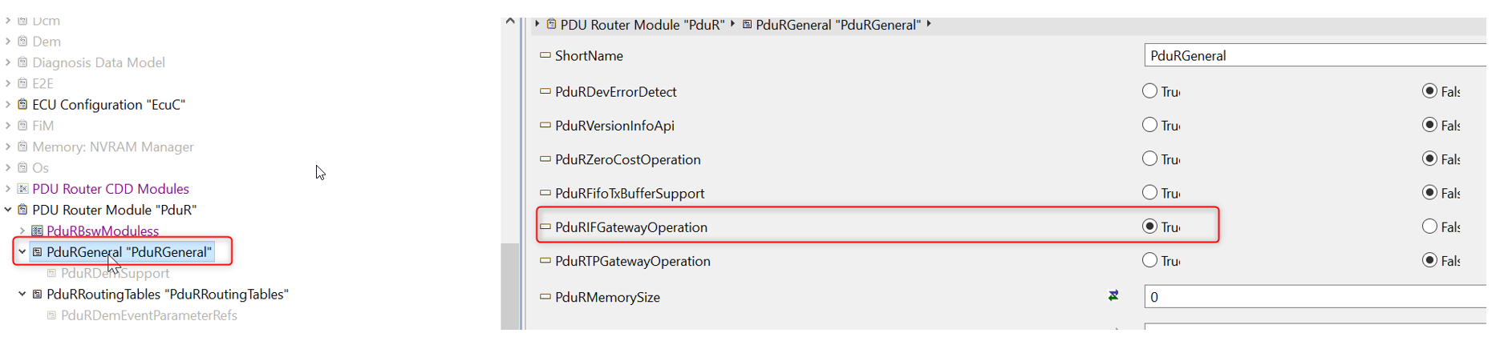
Detail implementation
Provide the CAN hardware object for the Source and Target as normal
Provide the CANIf configuration as normal messages, and these message need to route to PDUR.
Depend on your case: Whatever it is, you need to Enable the If Gateway option in general PDUR configuration
Internal | Fixed-Term Phuong Le Trung (RBVH/EJV23) | 1/3/2021.

Slide 6
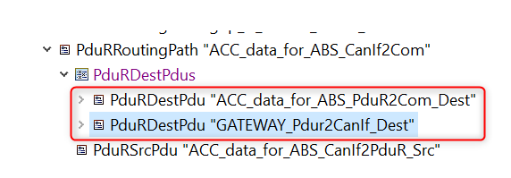
Detail implementation
a) If the message only for forwarding, no intended internal usage, then provide the mapping from Source CANIf2PduR to Target CANIf2PduR.
b) If you need to forward it to multiple other CANs channel; or in case you want forwarding and internal ECU usage at the same time, then provide additional Destination configuration for the Source CANIf2PduR, like below
Internal | Fixed-Term Phuong Le Trung (RBVH/EJV23) | 1/3/2021.

Slide 7
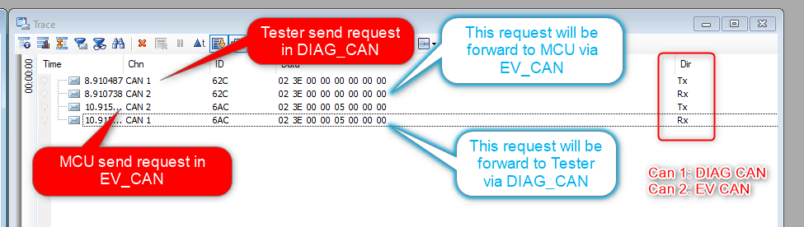
Output
Internal | Fixed-Term Phuong Le Trung (RBVH/EJV23) | 1/3/2021.

Slide 8
Testing
Sending request from tester with below CAN ID:
$111 (AN_FR_UDS) $62A (USDT_PR_BMS) $62B (USDT_PR_DCDC12) $62C (USDT_PR_MCU) $633 (USDT_PR_OBC)
Check in CANoe window and below message should be appeared:
Request from Tester
$111 (AN_FR_UDS) → RX CAN_DIAG → TX CAN_EV $62A (USDT_PR_BMS) → RX CAN_DIAG → TX CAN_EV $62B (USDT_PR_DCDC12) → RX CAN_DIAG → TX CAN_EV $62C (USDT_PR_MCU) → RX CAN_DIAG → TX CAN_EV $633 (USDT_PR_OBC) → RX CAN_DIAG → TX CAN_EV
Response from MCU, BMS, DCDC12, OBC
$6AA (USDT_RS_BMS) → TX CAN_DIAG → RX CAN_EV $6AB (USDT_RS_DCDC12) → TX CAN_DIAG → RX CAN_EV $6AC (USDT_RS_MCU) → TX CAN_DIAG → RX CAN_EV $72A (UUDT_RS_BMS) → TX CAN_DIAG → RX CAN_EV $72B (UUDT_RS_DCDC12) → TX CAN_DIAG → RX CAN_EV $72C (UUDT_RS_MCU) → TX CAN_DIAG → RX CAN_EV $6B3 (USDT_RS_OBC) → TX CAN_DIAG → RX CAN_EV $733 (UUDT_RS_OBC) → TX CAN_DIAG → RX CAN_EV
Internal | Fixed-Term Phuong Le Trung (RBVH/EJV23) | 1/3/2021.

Slide 9
Refer information
I-SW: RQONE02879844: [ISZ][EV-ELF] Tester/CB - SW21 Delivery
|- I-FD: RQONE02950430: [ISZ][EV-ELF][OD0188FCTJ0017] ComDia / Gateway
|- I-FD: RQONE02950431: [ISZ][EV-ELF][OD0188FCTJ0018] CB / Gateway
Internal | Fixed-Term Phuong Le Trung (RBVH/EJV23) | 1/3/2021.

